Slide 1
Applied Machine Learning in CyberSecurity
Aung Myint Myat & Saw Win Naung
BSides Myanmar 2023
Notes:
Artificial intelligence which is a hot buzz nowadays and has firmly put down its roots in a vast multitude of industries that are investing in fields like Artificial Intelligence, Big Data and Analytics. For example, Google is using deep learning in its voice and image recognition algorithms whereas Netflix and Amazon are using it to understand the behavior of their customer. In fact, you won’t believe it, but researchers at MIT are trying to predict future using deep learning.
Applied topic
Only for detection
Introduce myself

Slide 2
About this topic
Cannot be a
ML scientist
Explain the maths behind the scene
Python guru
Can learn
Introduce useful toolkit for ML
How to develop machine learning models
Appliance of some machine learning models
Introduction to develop useful tools for cybersecurity
Notes:
This is 101 topic
We are here to present how a cyber security folks participate in AI area

Slide 3
Outline
Brief about artificial general intelligence (AGI)
Threat Detection in SOC
How machine learning can help in threat detection
SPAM/PHISH detection using maths
Network anomaly detection with Unsupervised Learning
Bad URL detection with Supervised Learning
C2 DGA detection with Neural Network
Use developed model in the production
Notes:
Artificial General Intelligence (AGI) refers to the development of machines that can perform any intellectual task that a human being can.
In a Security Operations Center (SOC), threat detection is a critical task, and machine learning can help improve the accuracy and efficiency of this process.
Machine learning algorithms can be used to analyze large volumes of data and identify patterns that indicate potential threats, such as spam and phishing emails, network anomalies, and malicious URLs.
Unsupervised learning techniques can be used to detect network anomalies without the need for prior knowledge of the specific threat.
Supervised learning techniques can be used to train models to detect bad URLs and C2 DGA, which can then be used in production to automatically identify potential threats.
It's important to regularly evaluate and improve these models to ensure their accuracy and effectiveness in detecting new and evolving threats.

Slide 4
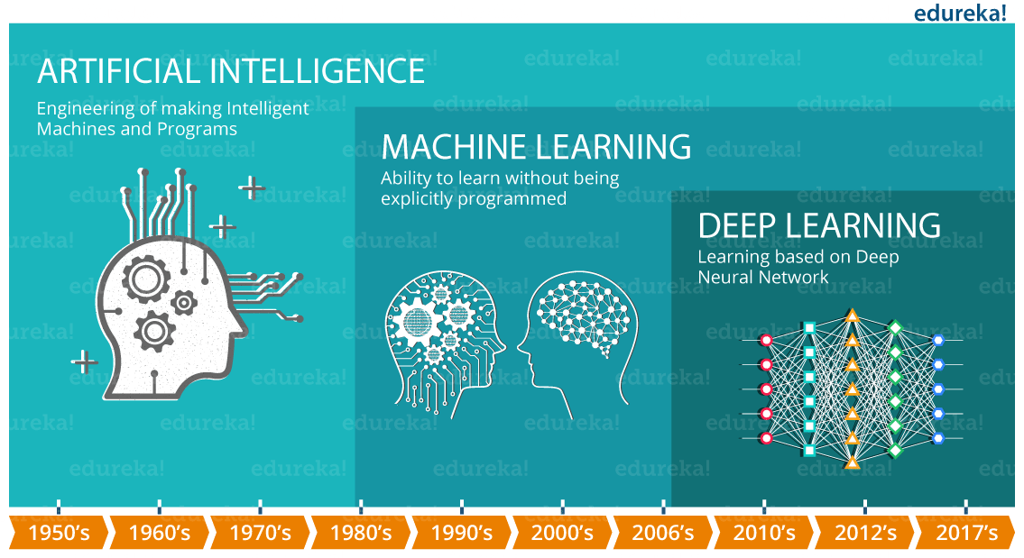
Brief history of AGI
Notes:
Before talking about deep learning, one must understand its relationship with Machine Learning and Artificial Intelligence.
The term AI was coined in 1956 by John McCarthy, who is also referred as Father of Artificial Intelligence. The idea behind AI is fairly simple yet fascinating, which is to make intelligent machines that can take decisions on its own. You may think it as a science fantasy, but with respect to recent developments in technology and computing power, the very idea seems to come closer to reality day by day.
ML is “A computer program is said to learn from experience E with respect to some task T and some performance measure P, if its performance on T, as measured by P, improves with experience E.” — Tom Mitchell, Carnegie Mellon University
Basically, deep learning mimics the way our brain functions

Slide 5
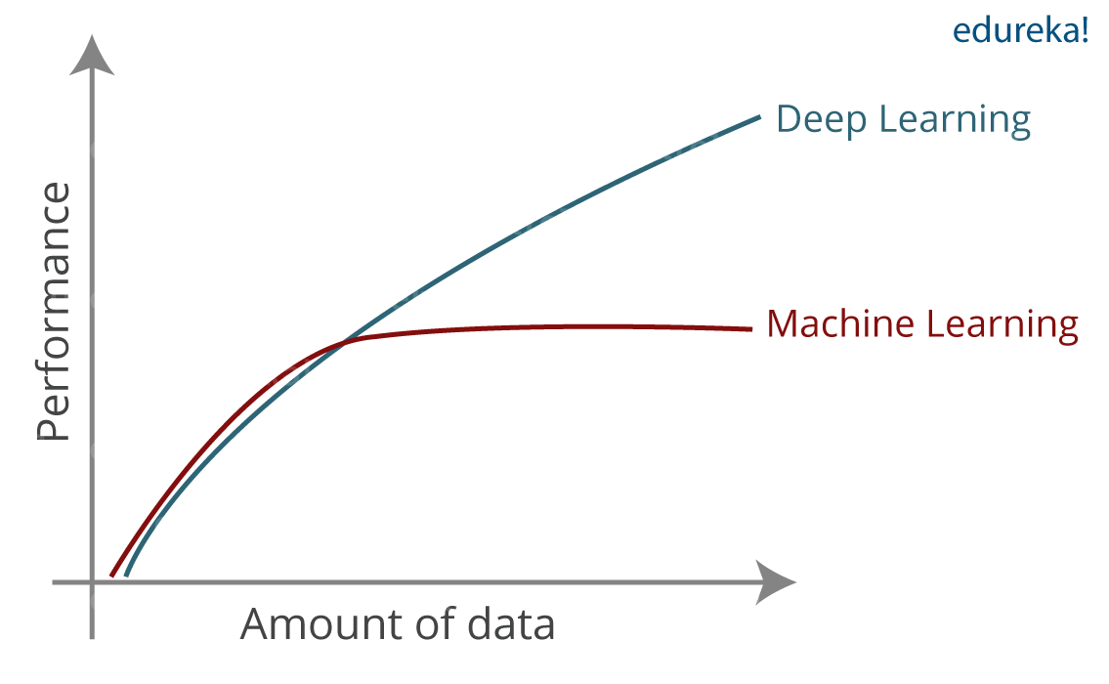
Trend Shifting
Notes:
Traditional ML algorithms are not useful while working with high dimensional data, that is where we have a large number of inputs and outputs. For example, in case of handwriting recognition we have large amount of input where we will have different type of inputs associated with different type of handwriting.
Second major challenge is to tell the computer what are the features it should look for that will play an important role in predicting the outcome as well as to achieve better accuracy while doing so. This very process is referred as feature extraction.

Slide 6
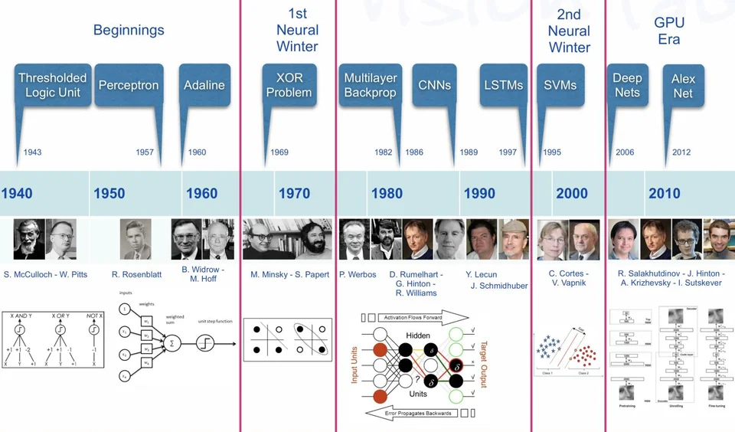
History of development
Notes:
The history of AI development dates back to the mid-20th century when researchers started exploring the possibility of creating machines that could simulate human intelligence. Here is a brief overview of some of the major milestones in AI development:
1950s - The birth of AI: The field of AI was formally established in 1956 when John McCarthy, Marvin Minsky, Claude Shannon, and Nathaniel Rochester organized the Dartmouth Conference, which brought together researchers from various fields to discuss the possibility of creating intelligent machines.
1960s - Early breakthroughs: During the 1960s, AI research made some significant breakthroughs, including the development of the first computer program capable of playing chess and the creation of the ELIZA program, which simulated a conversation with a psychotherapist.
1970s-1980s - Expert systems: In the 1970s and 1980s, the focus of AI research shifted towards developing expert systems, which were computer programs designed to replicate the decision-making abilities of human experts in specific domains.
1990s - Machine learning: In the 1990s, AI research began to focus more on machine learning, which involves creating algorithms that can learn from data and improve their performance over time.
2000s - Big data and deep learning: The rise of big data in the 2000s led to a renewed interest in deep learning, a subfield of machine learning that involves training neural networks with multiple layers to learn hierarchical representations of data.
2010s-present - AI boom: In recent years, AI has experienced a surge of interest and investment, driven by breakthroughs in areas such as natural language processing, computer vision, and reinforcement learning. AI is now being applied in a wide range of domains, from healthcare and finance to transportation and entertainment.
Overall, the history of AI development has been marked by a series of breakthroughs and setbacks, but the field continues to advance rapidly, with new applications and techniques emerging all the time.

Slide 7
Threat detection in cybersecurity
A mediocre SOC
IP/Domain/Hash intel
Attacker tools and tactics
Anomaly detection
Problems
IP, domains and hash are cheap
Analyst Skill Set
SIEM = Data silos
Notes:
Threat Detection
Network Monitoring: This involves monitoring network traffic to identify any suspicious activity or behavior. This can be done using tools such as intrusion detection systems (IDS) and intrusion prevention systems (IPS).
Endpoint Protection: Endpoint protection software can detect malware and other threats on individual devices such as desktops, laptops, and mobile devices.
Log Analysis: Logs generated by systems and applications can be analyzed to identify any unusual or suspicious activity that may indicate a potential threat.
Threat Intelligence: Threat intelligence involves gathering information about known or suspected threats and using this information to detect and prevent potential attacks.

Slide 8
How AI can help in detection
Notes:
How AI can help
Anomaly Detection: AI algorithms can be trained to detect anomalies in network traffic or system behavior that may indicate a potential threat. This can help identify threats that may be difficult to detect using traditional signature-based approaches.
Machine Learning: Machine learning algorithms can analyze large volumes of data and learn to identify patterns and correlations that may indicate a threat. This can help identify new or emerging threats that may not be covered by existing security rules.
Natural Language Processing (NLP): NLP techniques can be used to analyze text data, such as logs , to identify potential threats or attacks. This can help identify threats that may be hidden in large volumes of unstructured data.

Slide 9
First Generation of AGI (probability and statistics)
Case Study: A deck of cards.
Q1: What is the probability that, you would draw a card that is both a queen and black?
P(Q ∩ B) => P(Q) * P(B) = >4/52 * 26/52 => 1/13 * 1/2 => 1/26
Q2: What is the probability that, you would draw a card being a queen given that it is Black?
P(Q | B) => 2/26 => 1/13
Q3: What is the probability that, you would draw a card being black given that it is queen?
P(B | Q) => 2/4 = 1/2
Relation between Joint and Conditional Probabilities => P(Q ∩ B) = P(Q | B) * P(B)

Slide 10
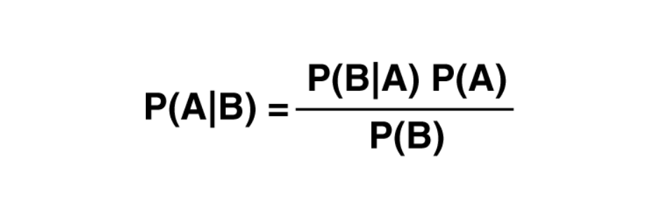
Bayes Theorem

Slide 11
Naive Bayes detection on SPAM
Naive Bayes is a classification algorithm in ML that is based on Bayes' theorem.
It assumes that the features (or attributes) used to classify a data point are independent of each other.
Simplifies the calculation of the conditional probabilities.
P(A∣B_{k})=Π_{i}P(A_{i}∣B_{k})
Often used for text classification tasks, such as spam detection, sentiment analysis, and topic classification. It can also be used for image classification, recommendation systems, and other supervised learning tasks.

Slide 12
Problem Statement - SPAM Emails
Lab1 - The problem of email spam detection involves identifying and classifying incoming emails as either spam or legitimate, based on their content and other relevant features. The goal is to develop an automated system that can accurately distinguish between spam and non-spam emails.

Slide 13
Lab 1

Slide 14
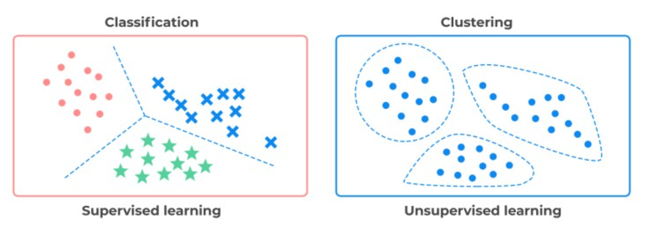
Machine Learning Terminology
Notes:
Supervised learning involves training a model on a labeled dataset, where the correct outputs are already known. The goal is to have the model learn a mapping from inputs to outputs, so that it can correctly predict the outputs for new, unseen inputs. The training process involves adjusting the model's parameters to minimize the difference between the predicted outputs and the actual labels in the training dataset. Supervised learning can be used for classification problems, where the goal is to predict a categorical label, or for regression problems, where the goal is to predict a continuous numerical value.
Unsupervised learning, on the other hand, involves training a model on an unlabeled dataset, where the outputs are not known in advance. The goal is to identify patterns or structure in the data, such as clustering similar data points together or identifying outliers. The training process involves finding a low-dimensional representation of the data that captures its underlying structure. Unsupervised learning can be used for tasks such as clustering, anomaly detection, and dimensionality reduction.
Both supervised and unsupervised learning have their own strengths and weaknesses, and the choice of which to use depends on the specific problem at hand and the available data.

Slide 15
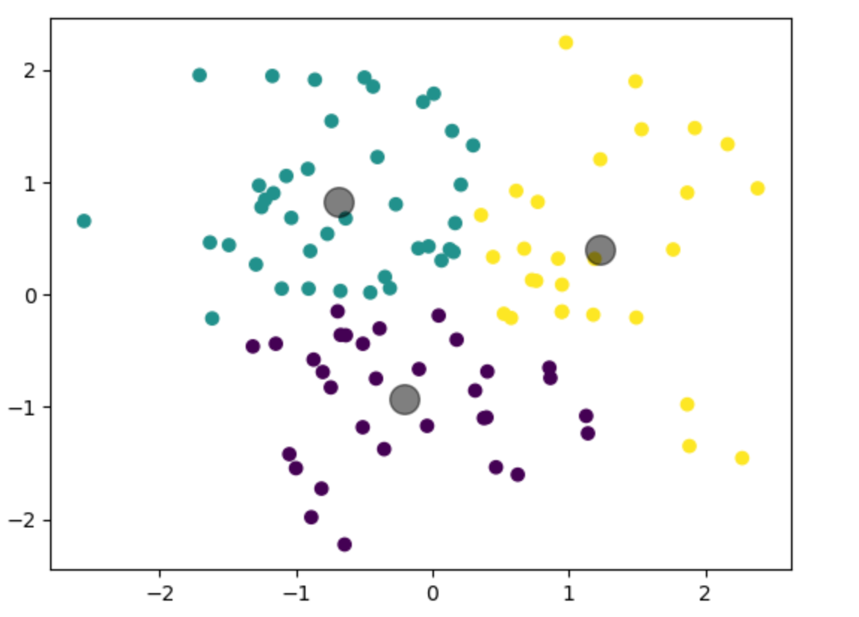
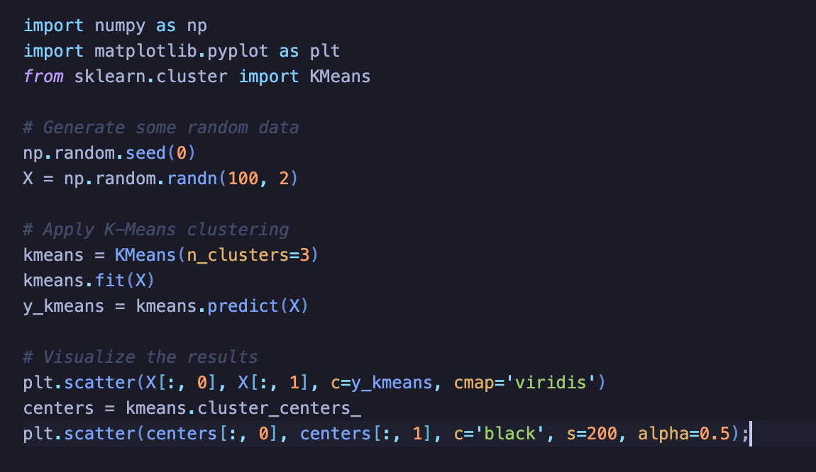
What is clustering?
Notes:
The clustering algorithm works by first defining a distance metric that measures the similarity between pairs of data points. This distance metric could be based on a variety of measures, such as Euclidean distance or cosine similarity. Once the distance metric is defined, the algorithm begins by randomly selecting a set of initial cluster centroids. These centroids can be selected randomly or based on some prior knowledge of the data.
Next, the algorithm assigns each data point to the closest centroid based on the distance metric. This creates an initial set of clusters, where each cluster consists of data points that are closer to their assigned centroid than to any other centroid. The algorithm then recalculates the centroids of each cluster based on the mean of the data points assigned to that cluster.
This process of assigning data points to clusters and recalculating the centroids continues iteratively until the centroids converge and the clusters no longer change. At this point, the algorithm has identified a set of clusters that group similar data points together.

Slide 16
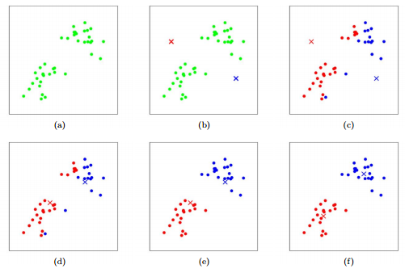
K-Mean Clustering
Initialize K cluster centroids.
Assign data points to clusters.
Recalculate the centroids.
Repeat steps 2 and 3: Iterate the above two steps until the cluster assignments no longer change significantly, or a maximum number of iterations is reached.
Output: K cluster centroids and the cluster assignments of each data point.

Slide 17
Problem Statement: Network Data Clustering
Lab 2.1: Given a large dataset of network connection logs (conn.log), the objective is to identify distinct groups or clusters of network connections based on their attributes such as source IP, destination IP, port numbers, connection duration, and bytes transferred. These clusters can provide insights into network traffic patterns, identify potential threats, and aid in network monitoring and management.

Slide 18
Lab 2.1

Slide 19
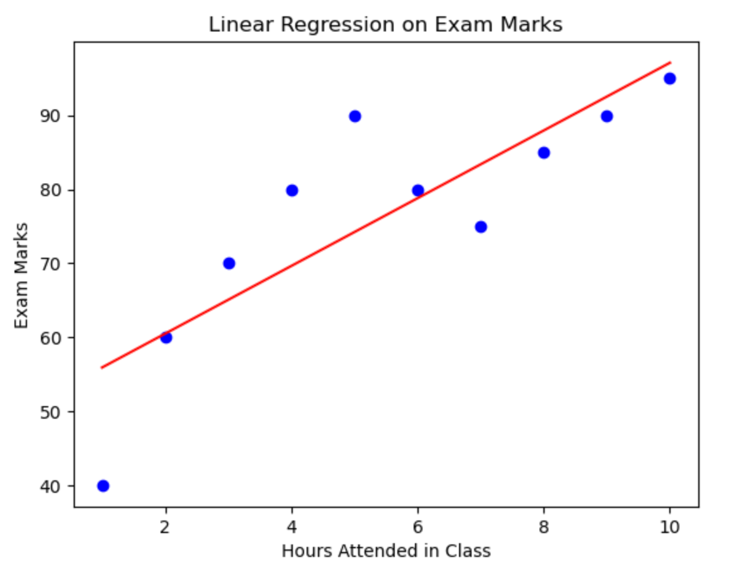
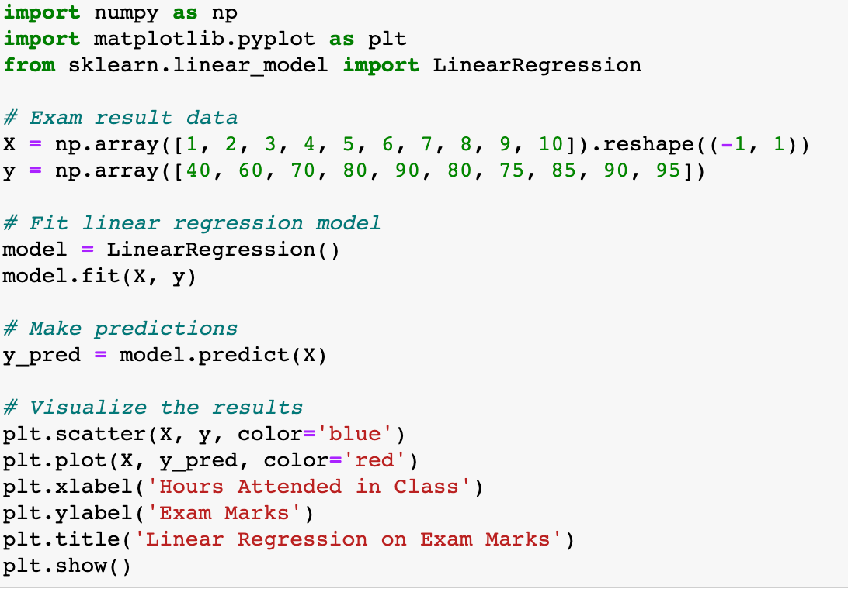
Linear Regression
Notes:
The training process in supervised learning classification involves providing the model with a labeled dataset and adjusting the model's parameters to minimize the difference between the predicted labels and the true labels in the training data. This is typically done using a loss function that measures the difference between the predicted and true labels, such as cross-entropy or hinge loss.

Slide 20
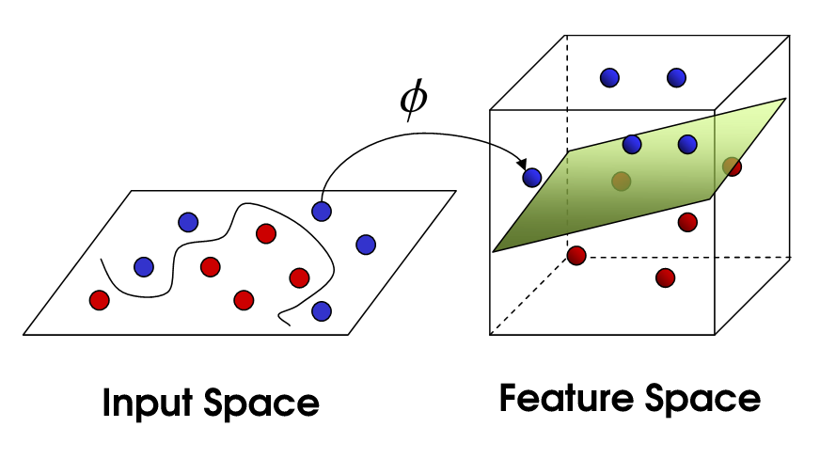
Classification - SVM
Input Data: The input data is fed into the SVM algorithm, which consists of a set of labeled training data that includes input features and their corresponding output labels.
Feature Mapping: SVM uses a kernel function to map the input features to a higher-dimensional space where the data can be separated by a hyperplane. This is done to transform the data into a more suitable form for classification.
Hyperplane Calculation: SVM finds the optimal hyperplane that maximizes the margin between the different classes. The margin is the distance between the hyperplane and the closest data points from each class. The hyperplane is calculated by finding the support vectors, which are the data points closest to the hyperplane.

Slide 21
Problem Statement: Malicious URL
Lab 2.2 Cyber attackers using URLs to distribute malware, steal sensitive information, or conduct other types of cyber attacks. Malicious URLs can be disguised as legitimate ones and can be spread via various channels, such as phishing emails, social engineering tactics, or compromised websites.
To detect malicious URLs with SVM, the URL features are extracted and converted into numerical vectors, which are used to train an SVM model that can classify URLs as either malicious or benign.

Slide 22
Detection malicious url with SVM
Data Collection: We will use dataset from kaggle
Data Preprocessing: In this step, the data is preprocessed to remove any outliers, missing values, or noisy data like .com and http://.
Feature Selection: In this step, the most relevant features are selected from the dataset. In here N-grams are contiguous sequences of words used as features.
Model Selection: The next step is to select the appropriate SVM model with SGD for the given dataset.
Training: The model learns the optimal hyperplane that maximizes the margin between the different classes.

Slide 23
Lab 2.2

Slide 24
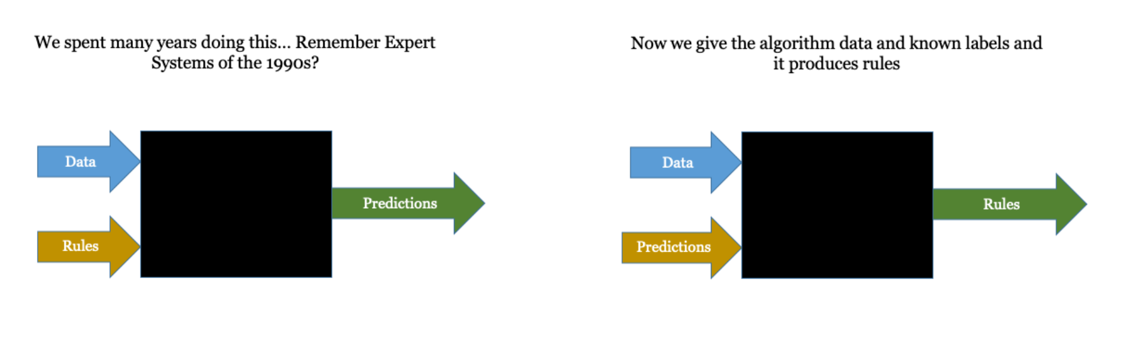
Introduction to Deep Learning
Notes:
Deep learning models consist of multiple layers of artificial neurons, which learn to recognize patterns and correlations in the input data. These models can be trained on large amounts of data to make accurate predictions, but the inner workings of the model are often difficult to interpret or explain.
One reason for the "black box" nature of deep learning models is that they can learn complex and nonlinear relationships between input features and output predictions. These relationships can be difficult to interpret or understand, especially when there are many layers and parameters involved in the model.

Slide 25
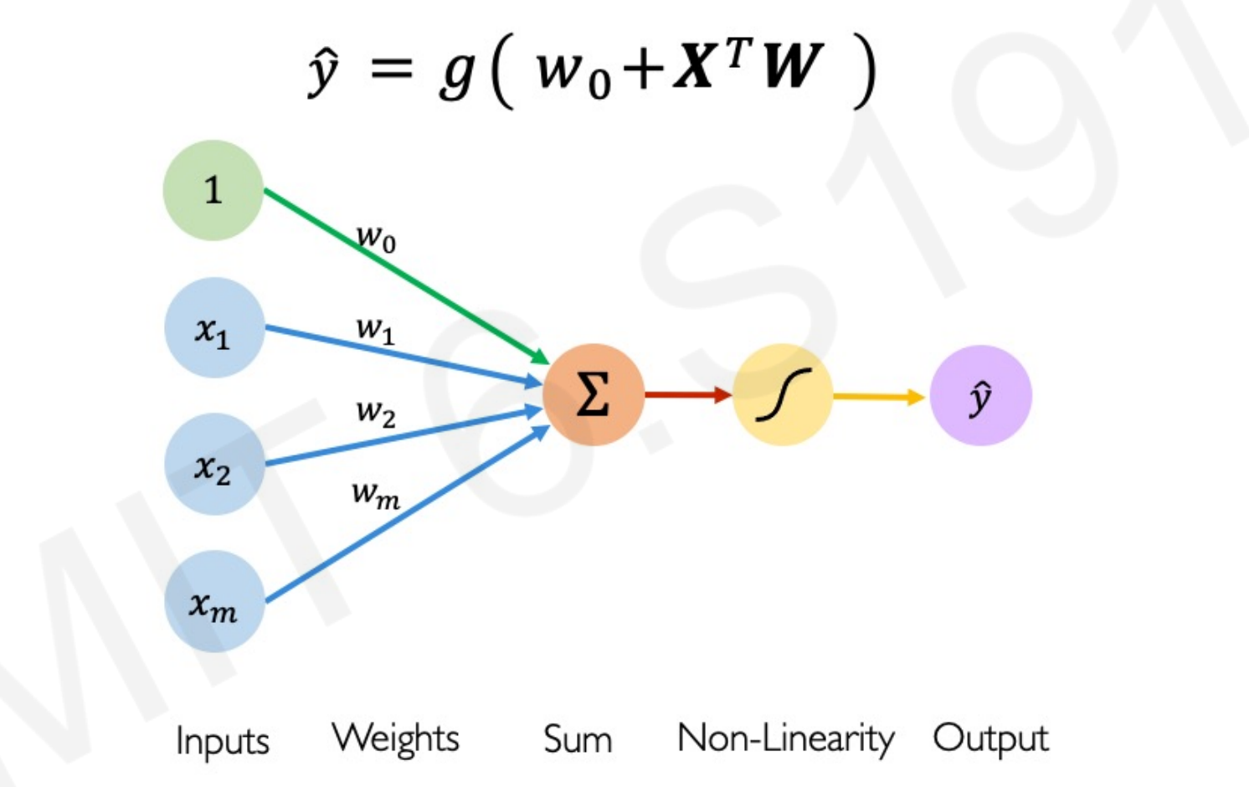
What is Perceptron?
Notes:
The perceptron takes in a vector of input features and computes a weighted sum of the input features, along with a bias term. The result is passed through an activation function, such as the step function or the sigmoid function, to produce a binary output (0 or 1), which corresponds to the predicted class label.

Slide 26
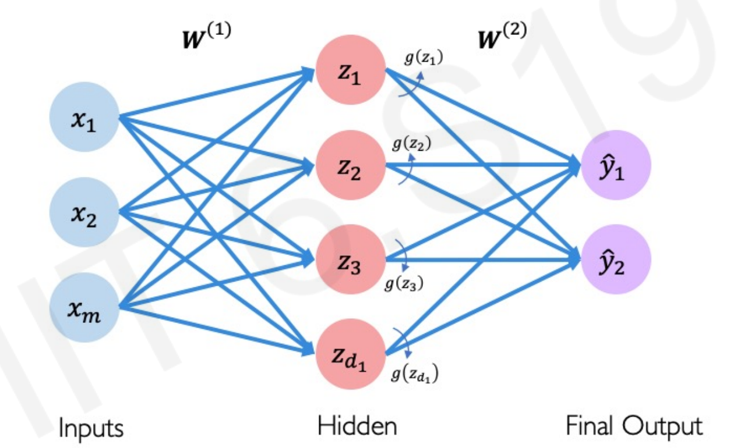
Perceptron To Neuron
Notes:
The basic structure of a neural network is similar to that of a perceptron, with input features fed into the neurons, which compute a weighted sum of the inputs and apply an activation function to produce an output. The output of one neuron can be fed as input to another neuron, allowing for the creation of complex, multi-layer networks.
The most common type of neural network is the multi-layer perceptron (MLP), which includes multiple layers of interconnected neurons. The first layer is the input layer, which takes in the input features. The subsequent layers are hidden layers, which learn increasingly abstract and complex representations of the input features. The final layer is the output layer, which produces the predicted output.

Slide 27
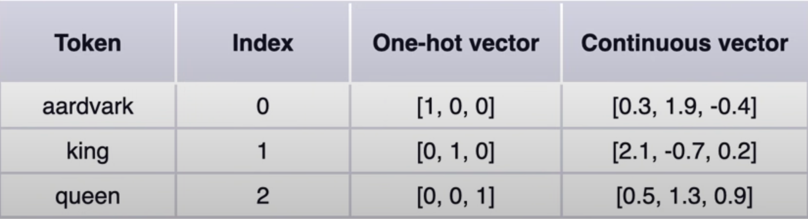
Text Encoding aka Word embeddings
Tokenization
Indexing
One-Hot-Encoding
Continuous Vector
Notes:
Tokenization is the process of splitting text into smaller units called tokens. These tokens can be words, phrases, or subwords, depending on the application. Tokenization is an essential step in natural language processing (NLP) tasks such as language modeling, machine translation, and sentiment analysis.
Indexing refers to the process of mapping each token to a unique integer index. This is necessary because machine learning algorithms cannot work with text data directly. Indexing is typically done using a vocabulary, which is a dictionary that maps each unique token to a unique index.
One-hot encoding is a technique for representing categorical data as binary vectors. In the context of NLP, this means representing each token as a binary vector where all entries are zero except for the entry corresponding to the index of the token, which is one. This representation is useful for feeding text data into machine learning models.
Continuous vector representations, also known as embeddings, are dense vector representations of tokens that capture semantic meaning. These embeddings are learned using neural network models such as word2vec and GloVe. Continuous vector representations are useful for NLP tasks such as information retrieval, sentiment analysis, and machine translation.

Slide 28
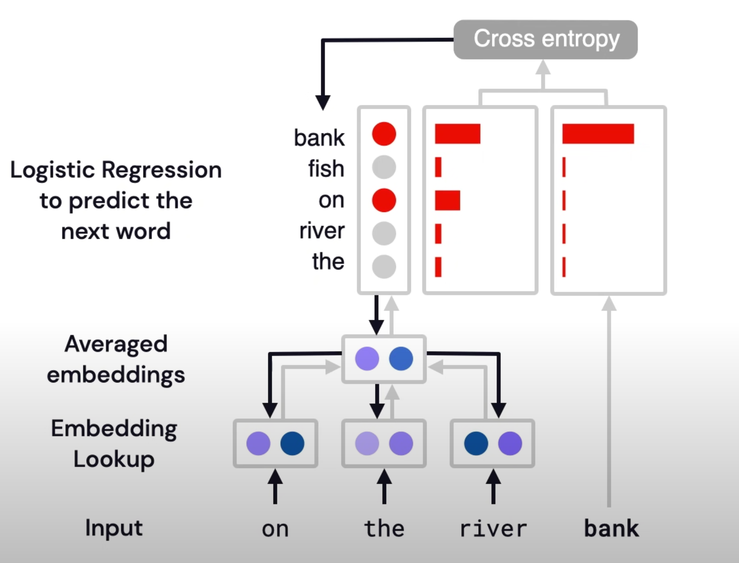
Language Models - Word2Vec
Notes:
Word2Vec is a neural network-based approach used to learn distributed representations of words. The general idea behind Word2Vec is to represent each word in a high-dimensional space (vector space) in such a way that words with similar meanings are close to each other in the space.
The training process involves feeding a large corpus of text as input to the neural network. The network learns to predict the probability of occurrence of a target word given its context words, or vice versa. In the process of learning, the network adjusts the weights of the connections between the input and output layers, which results in the creation of word embeddings that can be used for various natural language processing tasks.
There are two main architectures for Word2Vec: Continuous Bag-of-Words (CBOW) and Skip-Gram. CBOW predicts the target word based on its context words, while Skip-Gram predicts the context words based on the target word. The choice of architecture depends on the specific use case and the nature of the data.
The resulting word embeddings can be used in downstream tasks such as sentiment analysis, named entity recognition, and machine translation.

Slide 29
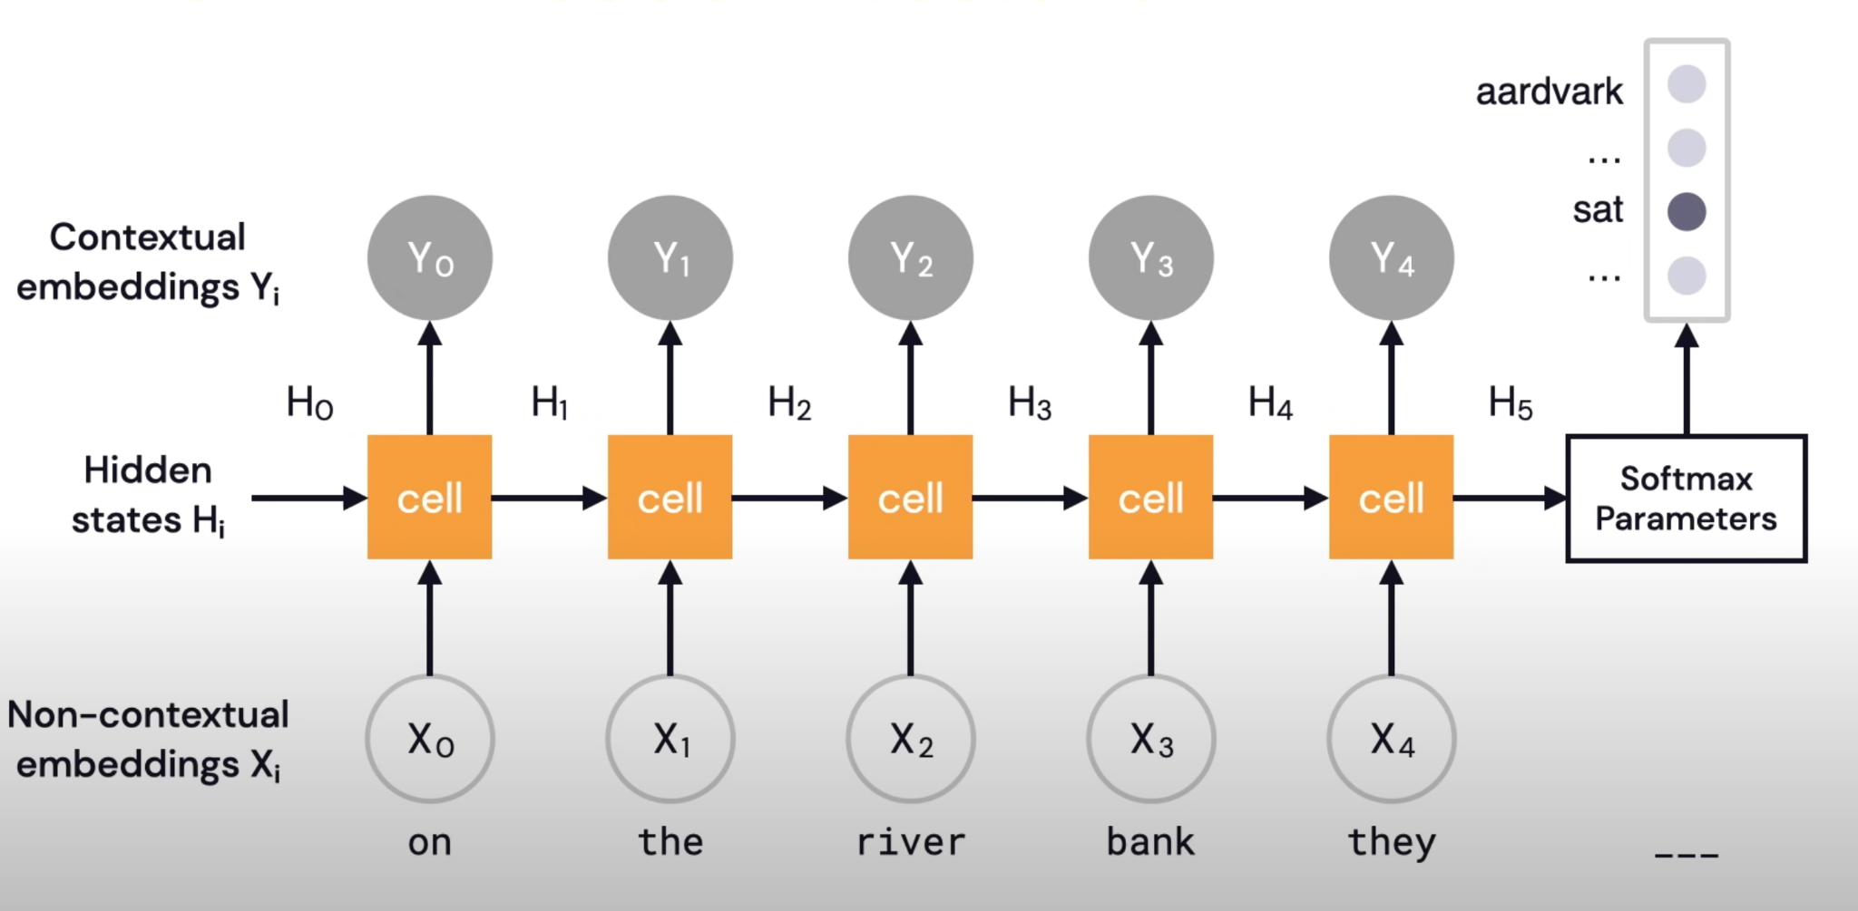
Language Model - RNN
Notes:
The basic building block of an RNN is the recurrent neuron, which takes an input and combines it with its previous state to produce an output and a new state that is fed back into the neuron for the next time step. The output at each time step depends not only on the current input but also on all previous inputs, allowing the network to capture temporal dependencies in the data.
There are several types of RNNs, including the basic RNN, the Long Short-Term Memory (LSTM) network, and the Gated Recurrent Unit (GRU) network. LSTMs and GRUs are designed to address the vanishing gradient problem that occurs in basic RNNs, which can prevent the network from effectively learning long-term dependencies.

Slide 30
Problem Statement: DGA
Command-and-Control (C2) server is used by attackers to control malware or a botnet. To avoid detection and mitigate the risk of being taken down, attackers often use Domain Generation Algorithms (DGA) to dynamically generate domain names for their C2 servers.

Slide 31
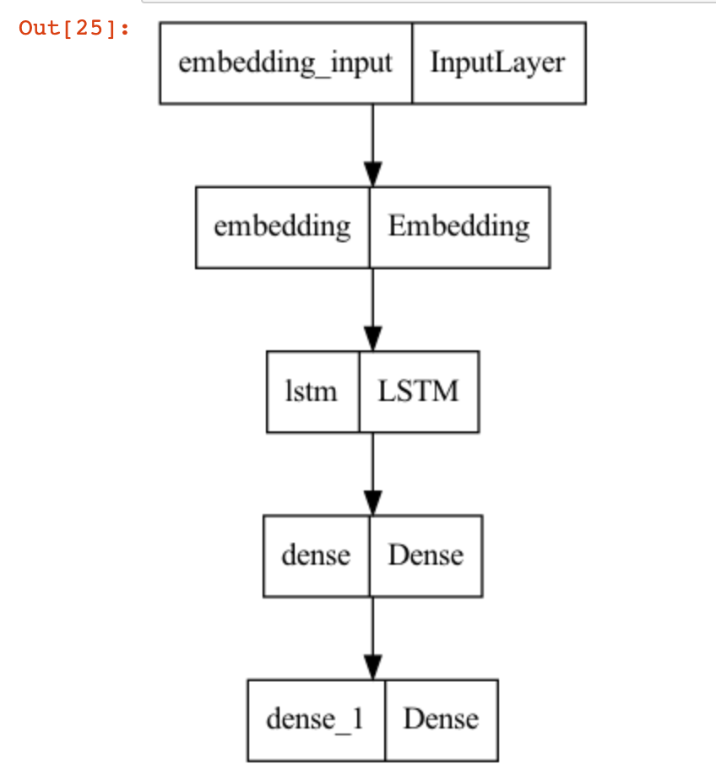
LSTM Model for Domain Generation Algo detection
LSTMs for DGA detection, the domains generated by DGAs are first collected and labeled as malicious or benign. These domains are then used to train the LSTM model to identify the patterns and features that distinguish malicious domains from benign ones.
The input to the LSTM model is a sequence of characters in a domain name, and the output is a binary classification indicating whether the domain is malicious or benign. The LSTM model is trained on a large dataset of domain names, using techniques such as dropout and early stopping to prevent overfitting.
During inference, the LSTM model takes a domain name as input and predicts the probability that the domain is malicious. If the probability exceeds a threshold, the domain is classified as malicious and can be blocked or investigated further.
Notes:
During training, the weights of the RNN are adjusted based on the errors between the predicted output and the true output in the training data. This process, known as backpropagation through time (BPTT), involves propagating the error back through the sequence of cells and updating the weights accordingly.
There are also variations of RNNs, such as Long Short-Term Memory (LSTM) and Gated Recurrent Unit (GRU), that are designed to address the "vanishing gradient" problem, which can occur when training deep RNNs. These models use additional gates and memory cells to better preserve and update the hidden state vector, allowing the network to learn long-term dependencies more effectively.

Slide 32
Lab 3.1

Slide 33
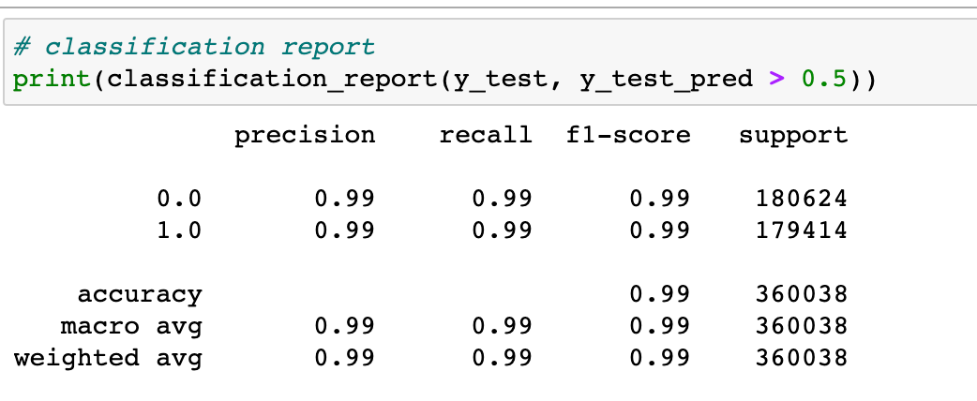
Evaluate and Validate the model
Confusion Matrices
Precision
Recall
Specificity
Notes:
Confusion matrix is a table used to evaluate the performance of a classification model by comparing the predicted labels with the actual labels. It is a 2x2 matrix that includes four measures: true positives (TP), false positives (FP), true negatives (TN), and false negatives (FN).
Precision is a measure of the accuracy of positive predictions. It is calculated by dividing the number of true positives by the sum of true positives and false positives. It tells us how often the model correctly identifies positive instances.
Recall, also known as sensitivity or true positive rate, is a measure of the completeness of positive predictions. It is calculated by dividing the number of true positives by the sum of true positives and false negatives. It tells us how often the model correctly identifies positive instances out of all actual positive instances.
Specificity is a measure of the accuracy of negative predictions. It is calculated by dividing the number of true negatives by the sum of true negatives and false positives. It tells us how often the model correctly identifies negative instances.
In summary, confusion matrices, precision, recall, and specificity are important measures for evaluating the performance of a classification model. A confusion matrix summarizes the number of true positives, false positives, true negatives, and false negatives in a tabular format. Precision and recall are measures that focus on positive predictions, while specificity focuses on negative predictions.

Slide 34
Integration in SOC
Elastic SIEM
eLand Import Model
SPLUNK
The Splunk App for Data Science and Deep Learning (DSDL)
Universal way
Model Serving with REST Api

Slide 35
Final Lab:

Slide 36

Attention is all you need
Notes:
"Attention Is All You Need" is a seminal research paper published by Google researchers in 2017, which introduced the Transformer model for natural language processing (NLP) tasks. The Transformer model is a neural network architecture that uses self-attention mechanisms to process input sequences and generate output sequences.
Unlike previous NLP models, which relied on recurrent or convolutional layers to process sequences, the Transformer model processes the entire input sequence at once using multi-headed self-attention mechanisms, allowing it to capture long-range dependencies and improve performance on tasks such as machine translation and text generation.

Slide 37
Thanks

